Slide 1
Continuous not grid world
agent = MazeAgent(dt=0.05, v=0.1, numRooms=1, roomSize=1, policy='randomWalk')
agent.walls['barrier'] = np.array([[[0.3,0.7],[0.7,0.3]]])
for i in tqdm(range(2000)):
agent.movementPolicyUpdate()
fig, ax = agent.plotHistory()
Position is a continuous variable:
Walls are true 1D objects
A check is done on each step to handle wall collisions
A function maps continuous position to a (quantized?) state-rep, e.g. one-hot

Slide 2
Generalised SR-TD
Use general SR form. M is a matrix which maps some state vector onto another vector which I the discounted summer future occupancy
I.e. Ψ(S) is:
So we can learn Ψ(S) by standard TD methods
Or as a direct learning rule on M, this is can be rewritten as (assuming rescaling of α or normalised state vectors)
All that remains is to show that with one-hot numbered states, f(S_{t})_{i} = δ(i = S_{t}), standard SR equation comes out.
Shouldn’t matter if f is not normalised as this is absorbed into alpha
e.g. de Cothi 2020, it’s what I’m implementing
matrix columns give future occupancy i.e. place fields
e.g. Stachenfeld 2017

Slide 3
Place cells and grid cells
agent.alpha = 0.2
agent.gamma = 0.99
agent.dx = 0.1
for i in tqdm(range(100000)):
agent.movementPolicyUpdate()
agent.TDLearningStep()
fig, ax = agent.plotPlaceField()
fig, ax = agent.plotGridField()
γ = 0.9
γ = 0.999
Place cells leak over barrier since positions on either side of the barrier can map to same state rep

Slide 4
Two rooms
agent.doorsClosed = True
agent.doorsClosed = False
Biggest problems:
• Can be slow to train
• Defining position to state rep function non-trivial (I guess that’s the whole point)

Slide 5
Four rooms
Biggest problems:
• Can be slow to train
• Defining position to state rep function non-trivial (I guess that’s the whole point)

Slide 6
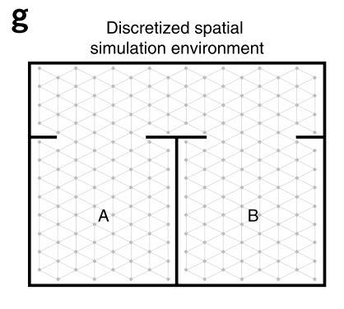
Grid cells bleeding across boundaries
Vertical / horizontal boundaries only ☹
Biggest problems:
• Can be slow to train
• Defining position to state rep function non-trivial (I guess that’s the whole point)

Slide 7
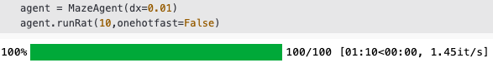
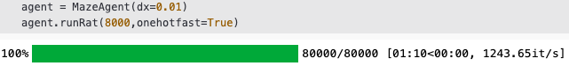
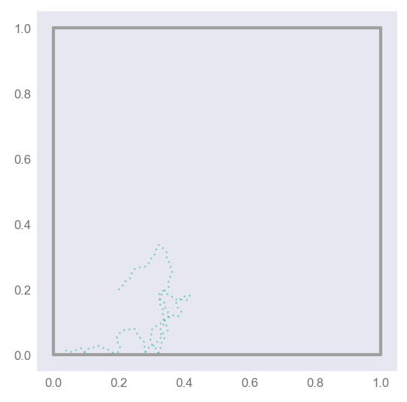
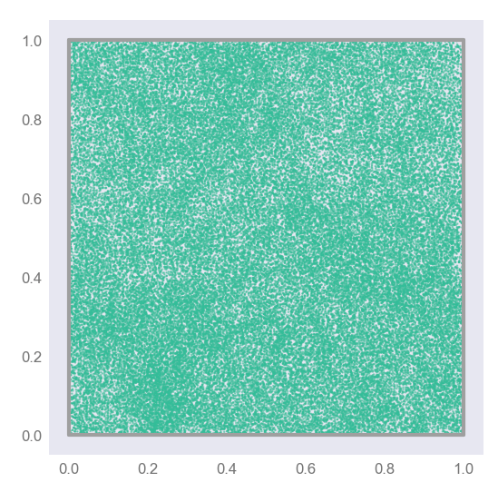
Code speed-up, O(1000x)
General formula:
One-hot specific formula:
Biggest problems:
• Can be slow to train
• Defining position to state rep function non-trivial (I guess that’s the whole point)

Slide 8
Motion models
Random Walk
Raudies
Windows screensaver

Slide 9
New mazes
Explore
Place
Grid

Slide 10
Continuous time and state TD learning:
Discrete state (one-hot)
Discrete time
Continuous state (e.g. BVCs)
Discrete time
Continuous state and time
e.g. Doya, 1996
Decouples γ from dt, i.e. decouples learning from the motion model

Slide 11
Proof:
normalised
Logical continuous-time
analogue
True if our estimate of Ψ, is correct
If it isn’t, we should update it (TD learning)
Re-discretising we get:
Or equivalently:
#time-step independent TD update
delta = state + (self.tau / dt) * (self.M @ ((1 - dt/self.tau)*state - prevState))
self.M = self.M + alpha * np.outer(delta, state)

Slide 12
Independence on dt
dt = 0.01
dt = 0.1
dt = 0.2
Dependence on τ
Tau = 1s
Tau = 2s
Tau = 4s

Slide 13
If τ → 0, Ψ → f
Zero iff:
Equivalent proof

Slide 14
Biologically inspired basis sets
In Will and Caswell’s neurobiological successor feature paper place cells are define as:
I.e. each row is a different (thresholded) successor features. We call this a “place cell”.
There is one place cell corresponding to each basis cell (BVC, HDC or whatever)

Slide 15
Successor features as a “causality obeying” smoothing convolution
Ψ (place cell) is essentially f (basis cell) “smoothed” with an exponential kernel
The smoothing is predominantly along directions likely to be visited in the near future.
RandomWalk
Raudies

Slide 16
Gaussian receptive field basis (and a new colour map)
Learned ‘place cells’
Threshold = 0.5 max
Basis cells
Bonus, resolution independent
(here 1mm precision)
All place
field locations
Successor
matrix

Slide 17
Fourier basis
Basis cells (100 cells)
Learned ‘place cells’
Bonus, resolution independent
(here 1mm precision)

Slide 18
Circle basis
Basis cells (100 cells)
Learned ‘place cells’
No threshold on place cells for clarity.
Biologically implausible but easy to
see the ‘smoothing effect’
τ = 1 therefore smoothing distance roughly v• τ = 0.16m

Slide 19
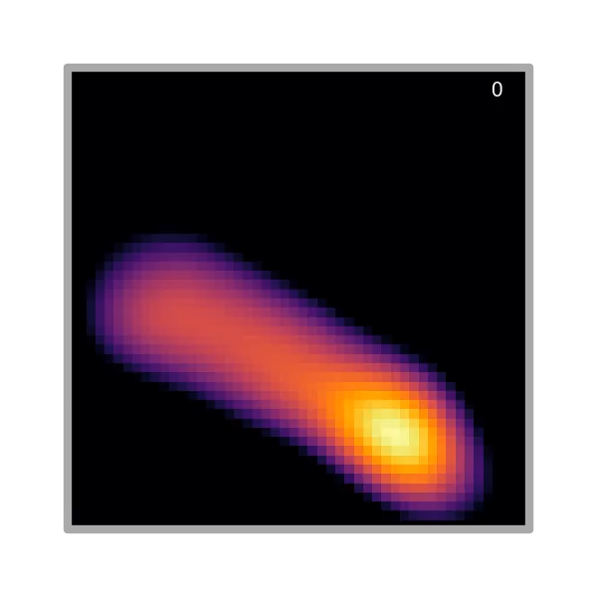
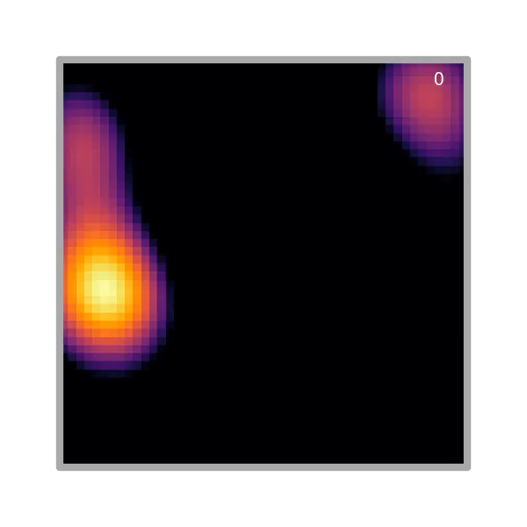
The birth of a place cell
Constant α
Exponentially decaying α

Slide 20
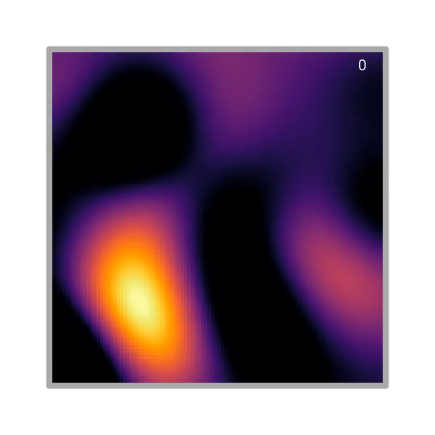
The birth of a grid cell

Slide 21

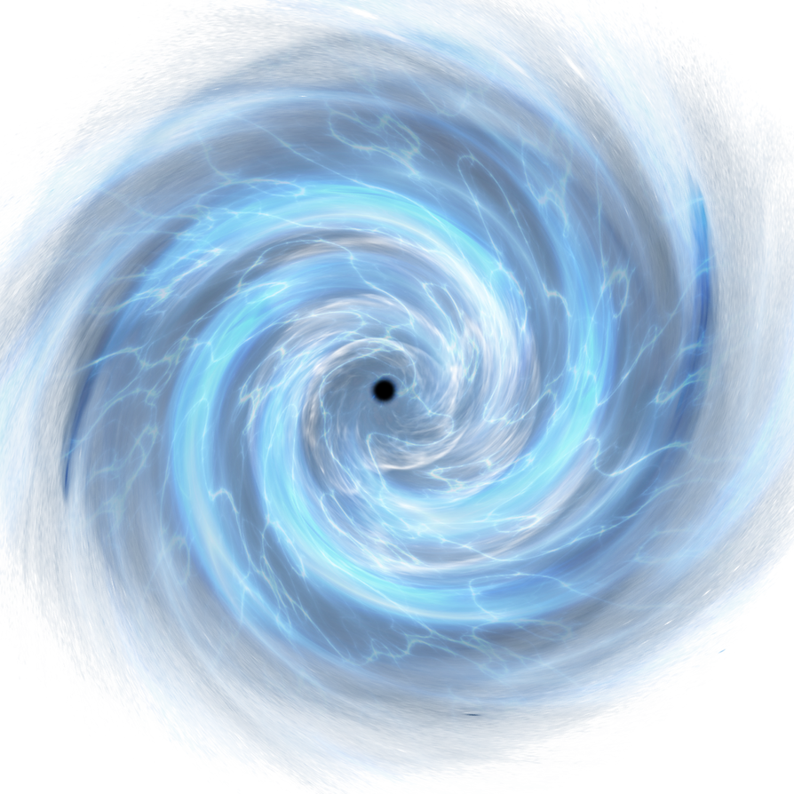
Implementing circular maze without corners
=
=

Slide 22
Circular maze

Slide 23

Circular maze

Slide 24
Separated simulation time step from TD learning
if np.linalg.norm(self.pos - hist_pos[lastTDstep]) >= 0.02: #if it's moved over 2cm meters from last step
dt_TD = self.t - hist_t[lastTDstep]
self.TDLearningStep(pos=self.pos, prevPos=hist_pos[lastTDstep], dt=dt_TD, tau=self.tau, alpha=alpha_)
lastTDstep = i

Slide 25
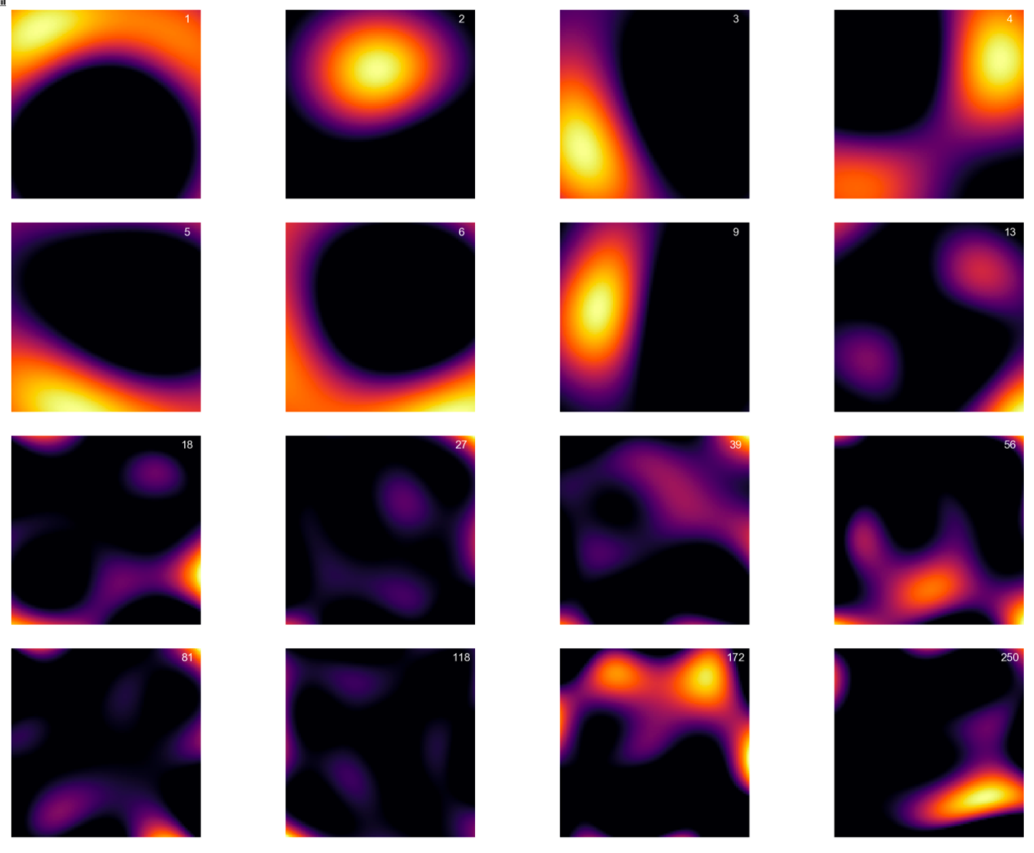
Fixed numerical instabilities
Place fields arranged by x-location

Slide 26
I’m confident in loop maze results now
Rat runs for 100 minutes in ’loop’ maze.
TD learning step every 2cm
Turn down rotational velocity so rat moves up and down maze
Grid cells primarily one dimensional
“End cells”
Boundary cells

Slide 27
Comparison of loop open to loop closed

